Slide 1
How to :
Data Flow Diagrams (DFDs)

Slide 2
Data Flow Diagram: Developed By Larry Constantine as a way of expressing system requirements in graphical Form:
Data Flow Models (DFMs) are easy to understand and, with a little practice, reasonably quick and straightforward to develop
They consist of two parts: a set of Data Flow Diagrams (DFDs) and a set of associated textual descriptions
… that provide us with the truly effective tool for understanding the information processes of a system

Slide 3
Objectives of Data Flow Diagram:
To define what is meant by structured analysis.
To define the symbols used in a Data Flow Diagram (DFD).
To draw a context diagram (Level 0 DFD) for a given scenario.
To refine a DFD to a more detailed (lower-level) view.

Slide 4
Using Data Flow Diagrams:
structured approach - take a top-down approach to system development.
system is defined first at a general level – overview.
successive refinement occurs until the bottom (primitive) levels are defined.
primitive level - point where specifications can be translated into lines of code.
So...system is decomposed into small modules that perform simple tasks.

Slide 5
Structured Development:
definition is from top to bottom in increasing levels of detail.
major flows and processes identified .
These are exploded into subprocesses.
Subprocesses are exploded into more detail.
This process can continue to the primitive level, where programming begins directly from the exploded diagram.

Slide 6


















Slide 7
Logical DFDs:
shows sources and sinks (destinations) of data
identifies and names the logical functions (processes) of the system.
identifies and names the groups of data elements that connect one process to another.
identifies the data stores.
each function broken down into more detailed DFD (levels).
descriptions of processes, flows, stores, elements recorded in data dictionary.

Slide 8
Logical DFDs:
All of the above documentation comprises a logical functional specification for an existing or new system.
A detailed statement of what the system does/is to do.
Free from physical considerations of how it will be implemented.

Slide 9
DFD is not a FlowChart!
Flow chart shows “ flow of Control “ .
DFD shows “ flow of Data”
The flowchart describes boxes that describe computations, decisions, interactions & loops.
It is important to keep in mind that data flow diagrams are not flowcharts and should not include control elements.

Slide 10
DFD Symbols (Gane & Sarson)
Four Elements of DFD
Process
Data Flow Data Store
Source/Sink (External Entity)

Slide 11
Data Flow Diagrams (DFDs)
Data flow diagram (DFD) is a picture of the movement of data between external entities and the processes and data stores within a system
CUSTOMER
Order
In-Stock Request
WAREHOUSE
Status Message
1.0
Check Status
Shipping Order
Status Data
2.0
Order Data
Shipping Confirmation
Pending Orders
3.0
Issue Status Messages
D1
Generate
Order Data
Shipping Order
Payment
4.0
Invoice
Order Data
Manage Accounts Receivable
5.0
Accounting Data
Accounts Receivable Data
D2
Produce Reports
Accounts Receivable
Inventory Reports
ACCOUNTING

Slide 12
Process
1.0
Grade Detail
Grade Report
Produce Grade Report
Work or actions performed on data (inside the system)
Labels should be verb phrases
Receives input data and produces output

Slide 13
Rule 1: Process
Can have more than one outgoing data flow or more than one incoming data flow
1.0
Graded Work
Submitted Work
Grade Student Work
Student Grade
3.0
Hours Worked
Gross Pay
Pay Rate
Calculated Gross Pay

Slide 14
Rule 2: Process
Can connect to any other symbol (including another process symbol)
1.0
2.0
Inventory Change
Order
Accepted Order
Verify Order
Assemble Order

Slide 15
Process: Correct/Incorrect?
5.0
Services Perfomed
Invoice
Create Invoice
Policy Number
Payment Amount
Apply Insurance Premium
2.1
Hours Worked
Pay Rate
Calculate Gross Pay

Slide 16
Data Flow
Deposit
Is a path for data to move from one part of the IS to another
Arrows depicting movement of data
Can represent flow between process and data store by two separate arrows
2.1
Payment Detail
D1
Accounts Receivable
Post Payment
Invoice Detail

Slide 17
Data Flow: Correct/Incorrect?
5.0
Post Payment
Courses
Customer Payment
Class List
D2
Daily Payments
Daily Payment
Students
6.0
Prepare Deposit

Slide 18
Data Store
D1
Students
Is used in a DFD to represent data that the system stores
Labels should be noun phrases

Slide 19
Rule: Data Store
Must have at least one incoming and one outgoing data flow
Customer Payment
D1
Daily Payments
Daily Payment

Slide 20
Data Store: Correct/Incorrect?
2.0
D2
Accounts Receivable
Book Flight
Invoice Detail
Payment Detail
Fight Request
3.0
Passengers
Post Payment

Slide 21
Source/Sink (External Entity)
Order
1.0
CUSTOMER
Invoice
Verify Order
External entity that is origin or destination of data (outside the system)
Is the singular form of a department, outside organisation, other IS, or person
Labels should be noun phrases
Source – Entity that supplies data to the system
Sink – Entity that receives data from the system

Slide 22
Rule: Source/Sink
Must be connected to a process by a data flow
BANK
Bank Deposit
2.0
Prepare Deposit

Slide 23
Source/Sink: Correct/Incorrect?
PAYROLL DEPARTMENT
 | Paycheck
CUSTOMER
CUSTOMER
Payment
Payment
EMPLOYEE
3.0
Accounts Receivable
Apply Payment

Slide 24
Rules for Using DFD Symbols
Data Flow That Connects
YES NO
A process to another process
A process to an external entity
A process to a data store
An external entity to another external entity
An external entity to a data store
A data store to another data store

Slide 25
List the errors of this DFD
E1
DF2
1.0
DF5
P2
DF1
DS1
DF3
DF6
DF4
2.0
DF2
P1
E1

Slide 26
Context Diagram or Level 0 DFD
Top-level view of IS
Shows the system boundaries, external entities that interact with the system, and major information flows between entities and the system.
It’s designed to be an abstraction view, showing the system as a single process with its relationship to external entities. It represents the entire system as a single bubble with input and output data indicated by incoming/outgoing arrows.
Example: Order system that a company uses to enter orders and apply payments against a customer’s balance

Slide 27
Context Diagram of Order System
Order
WAREHOUSE
CUSTOMER
Order Reject Notice
Picking List
Payment
Invoice
0
Completed Order
Order System
Commission
Bank Deposit
Cash Receipts Entry
SALES REP
ACCOUNTING
BANK

Slide 28
Data flow diagram of a travel agent booking system: Level-0
Customer
Travel-query
Available flights
Book flight
flights
Booking confirmation
Booking

Slide 29
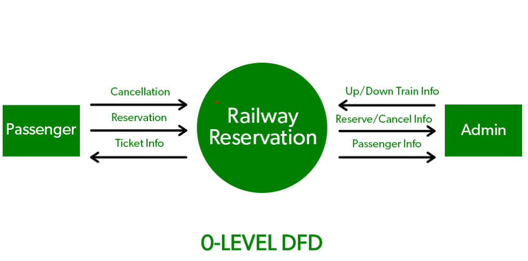

Slide 30
Level-1 DFD
Shows the system’s major processes, data flows, and data stores at a high level of abstraction
When the Context Diagram is expanded into DFD level-0, all the connections that flow into and out of process 0 needs to be retained.

Slide 31
Context Diagram of Order System
Order
WAREHOUSE
CUSTOMER
Order Reject Notice
Picking List
Payment
Invoice
0
Completed Order
Order System
Commission
Bank Deposit
Cash Receipts Entry
SALES REP
ACCOUNTING
BANK

Slide 32
CUSTOMER
Order
Picking List
WAREHOUSE
Level-1 DFD of Order System
1.0
Fill Order
Order Reject Notice
Invoice
2.0
Payment
Invoice
Create Invoice
Completed Order
D1 | Accounts Receivable
Payment Detail |  | Invoice Detail
3.0
Apply Payment
Commission
Bank Deposit
Cash Receipts Entry
SALES REP
BANK
ACCOUNTING

Slide 33
Lower-Level Diagrams
Functional Decomposition
An iterative process of breaking a system description down into finer and finer detail
Uses a series of increasingly detailed DFDs to describe an IS
Balancing
The conservation of inputs and outputs to a data flow process when that process is decomposed to a lower level
Ensures that the input and output data flows of the parent DFD are maintained on the child DFD

Slide 34
Strategies for Developing DFDs
Top-down strategy
Create the high-level diagrams (Context Diagram), then low-level diagrams (Level-0 diagram), and so on
Bottom-up strategy
Create the low-level diagrams, then higher- level diagrams

Slide 35
Exercise:
Precision Tools sells a line of high-quality woodworking tools. When customers place orders on the company’s Web site, the system checks to see if the items are in stock, issues a status message to the customer, and generates a shipping order to the warehouse, which fills the order. When the order is shipped, the customer is billed.
The system also produces various reports.
Draw a context diagram for the order system
Draw DFD diagram 0 for the order system

Slide 36
Identify Entities,Process,Data Stores & Data Flow
Entities
Customer
Warehouse
Accounting
Processes
1.0 Check Status
2.0 Issue Status Messages
3.0 Generate Shipping Order
4.0 Manage Accounts Receivable
5.0 Produce Reports
Data Stores
D1 Pending Orders
D2 Accounts Receivable
Data Flows
Order
In-Stock Request
Order Data
Status Data
Status Message
Shipping Order
Order Data
Invoice
1.0
■
2.0
3.0
Shipping Confirmation
Payment
Accounting Data
4.0
■
Accounts Receivable Data
Order Data
Inventory Reports
5.0

Slide 37
CUSTOMER
Order
WAREHOUSE
In-Stock Request
Payment
Status
0
Shipping
Message
Order
Order System
Invoice
Shipping Confirmation
Inventory Reports
ACCOUNTING
Context Diagram (Level 0) of Order System

Slide 38
CUSTOMER
Order
In-Stock Request
WAREHOUSE
Status Message
1.0
Check Status
Shipping Order
Status Data
2.0
Order Data
Shipping Confirmation
D1
Pending Orders
3.0
Issue Status Messages
Generate
Shipping Order
Order Data
Payment
4.0
Invoice
Order Data
Manage Accounts Receivable
5.0
Accounting Data
Accounts Receivable Data
D2 | Accounts Receivable
Produce Reports
Inventory Reports
Level-1 of Order System
ACCOUNTING

Slide 39

It is also known as a context diagram. It’s designed to be an abstraction view, showing the system as a single process with its relationship to external entities.

Slide 40
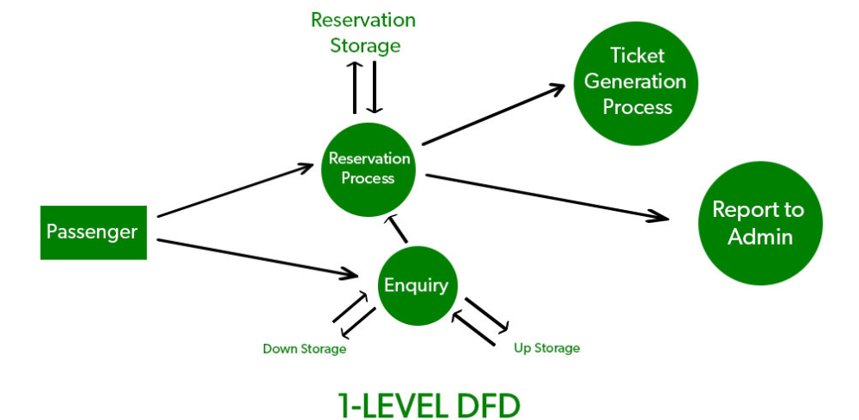
In 1-level DFD, the context diagram is decomposed into multiple bubbles/processes.

Slide 41
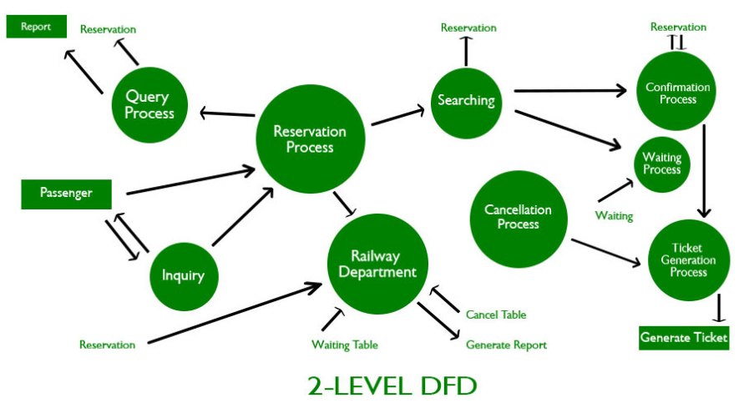
2-Level DFD can be used to plan or record the specific/necessary detail about the system’s functioning.

